Slide 1
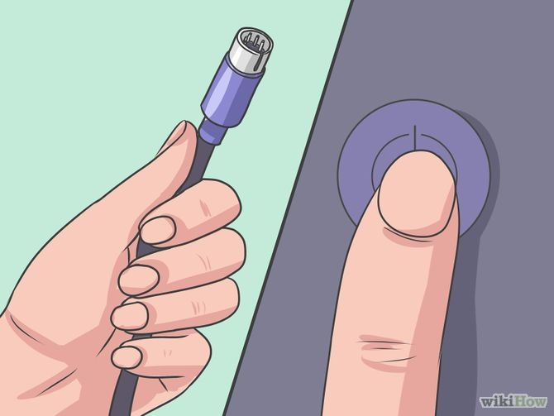
Turn off the computer and disconnect the keyboard before any cleaning procedure. Do not remove or connect a keyboard while the computer is on. If you do, you could damage the machine if your keyboard has no USB connection. If your keyboard has USB connection, then it is safe to disconnect while the computer is on.

Slide 2
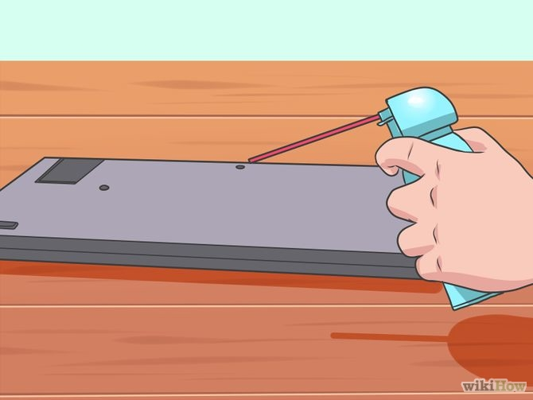
For a quick clean with the keyboard upside down and use a can of compressed air to remove any foreign matter. Be sure to do this in a place where they can clean up the trash that falls easily. Put the keyboard upside down and check air several times, you should see how it falls a little dirt. Change the angle and give a pat to make out most dirt.

Slide 3
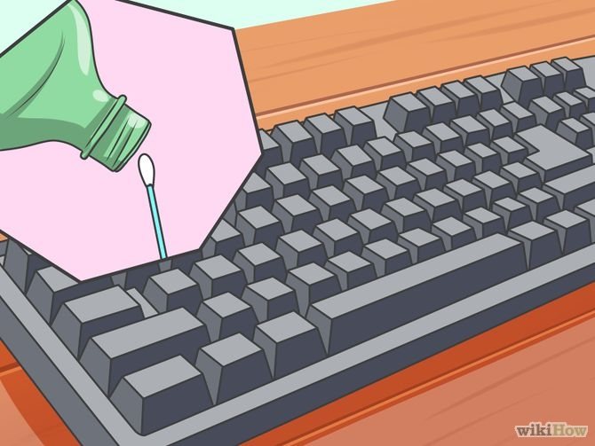
Clean the sides of the keys with a cotton swab soaked in isopropyl alcohol.

Slide 4
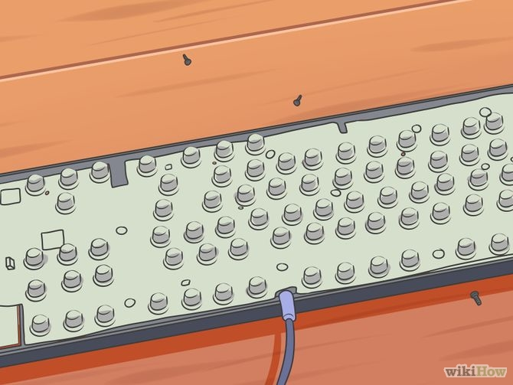
For a more thorough cleaning, remove all keys. Do this by prying up each key with a small screwdriver or something similar. When the keys have been removed, blow any dirt with compressed air. With a damp (but not wet), gently clean all surfaces. Do not let any kind of fluid in contact with the keyboard.

Slide 5
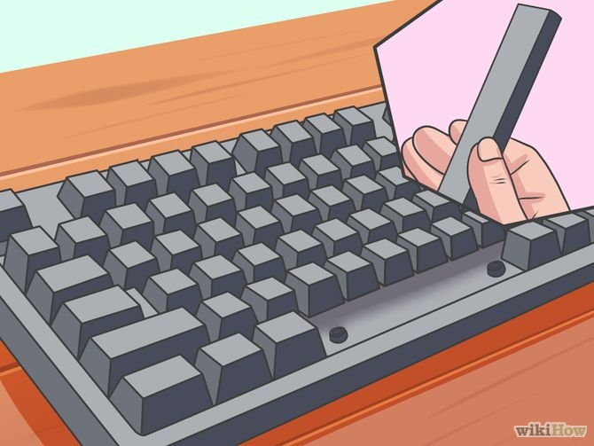
Clean the individual keys and place them back on the keyboard.

